Slide 1
Conducting experiments, recording output and analysing results of agent-based modelling for social scientists
The webinar will begin at 3pm
You now have a menu in the top right corner of your screen.
The red button with a white arrow allows you to expand and contract the webinar menu, in which you can write questions/comments.
Feel free to type questions as we go, we will answer as many as we can at the end
We can’t hear you.
Notes:
Hello everyone.
The webinar starts in 5 minutes.
Hopefully you can all hear me –you are on mute and will stay on mute throughout.
If you want to ask a question you can do so at any time by typing into the questions box at the top right of your screen – press the red arrow if you can’t see it.

Slide 2

Conducting experiments, recording output and analysing results of agent-based modelling for social scientists
Dr. J. Kasmire
UK Data Service
13 February 2020
Notes:
Thank you for joining us today.
My name is Dr. Julia Kasmire and today I am presenting a New Forms of Data Training on behalf of the UK Data services. Today’s webinar is called “Conducting experiments, recording output and analysing results of agent-based modelling for social scientists”.
That is quite a mouthful, so thanks for being brave and joining me today.
Before we get into the content today, I just want to double check if you can hear me properly.

Slide 3
Can you hear us?
?
Notes:
You should see a poll on your screen around about now.
Please respond to the poll to let us know whether you can hear us or not…
Yes
No

Slide 4
Can you hear us?
If not:
Check your volume, and that your speaker/headset is plugged in
Click on audio to change to listening via phone.
We are recording this webinar – we plan to put it on our website
Notes:
Great! The poll results are in.
This slide for anyone that cannot hear us. It just offers a few suggestions for dealing with audio problems.
I’ll just leave this slide up for a moment…
Moving on!

Slide 5
ABM for social scientists – webinar series
ABM: An Intro
– Jan 16, 2020, recording available
ABM: Adding Data
– Jan 30, 2020
ABM: Experiments and Output
– Feb 13, 2020
Notes:
Today’s webinar is the third in a series of three on the topic of agent-based modelling for social scientists.
Recordings of both previous webinars are already available to view on the UKDS YouTube channel. This final webinar will also soon be available to review on the UKDS YouTube channel.
If you are interested in attending an additional webinar on ABM as an opportunity to ask questions about how to apply ABM to your own research, please get in contact. This could include sending in questions or code examples in advance if you want me to address them. Please let me know if you are interested by emailing or tweeting me. My contact details are posted at the end of this webinar.

Slide 6
Table of Contents
Revisit the "Tram commute model“ – see it run!
Behaviour Space
Experimentation!
Getting the right output
Working with output
Summary
Questions
Notes:
We have a lot to cover today, so I will just chuck this table of contents at you for a moment.
If everyone is ready, then let’s get started!

Slide 7
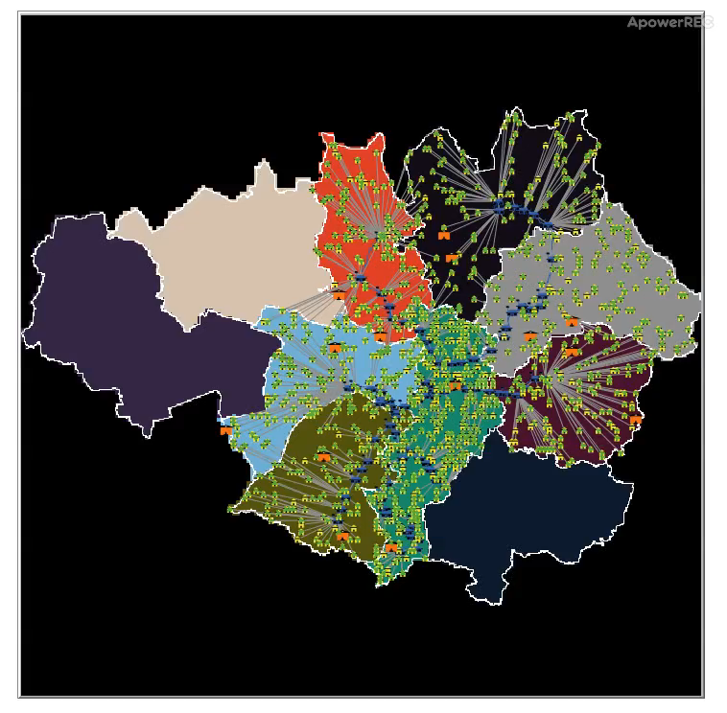
A moment to revisit the "Tram commute” model
Notes:
Since we had some serious technical failures last time, I thought it might be nice for me to explain a bit about the model while you can see it running.
So I will just push play…
This is a very basic approach to modelling commuters in the Greater Manchester Area. Houses full of commuters and places of interest are scattered across the local authorities that have tram stops, which are based on the actual locations of those tram stops as we saw in the last webinar. If you missed it, that webinar is available to rewatch on YouTube, with the technical hitches taken out.
This model assumes that everyone uses the tram so that all agents head to their nearest tram stop, ride the tram to the stop nearest their destination, and then get off. It also assumes that all trams go at the same speed, that there is no waiting at a tram stop for a tram to arrive, that everyone moves at the same speed when not on a tram, and that overcrowded trams are not possible.

Slide 8
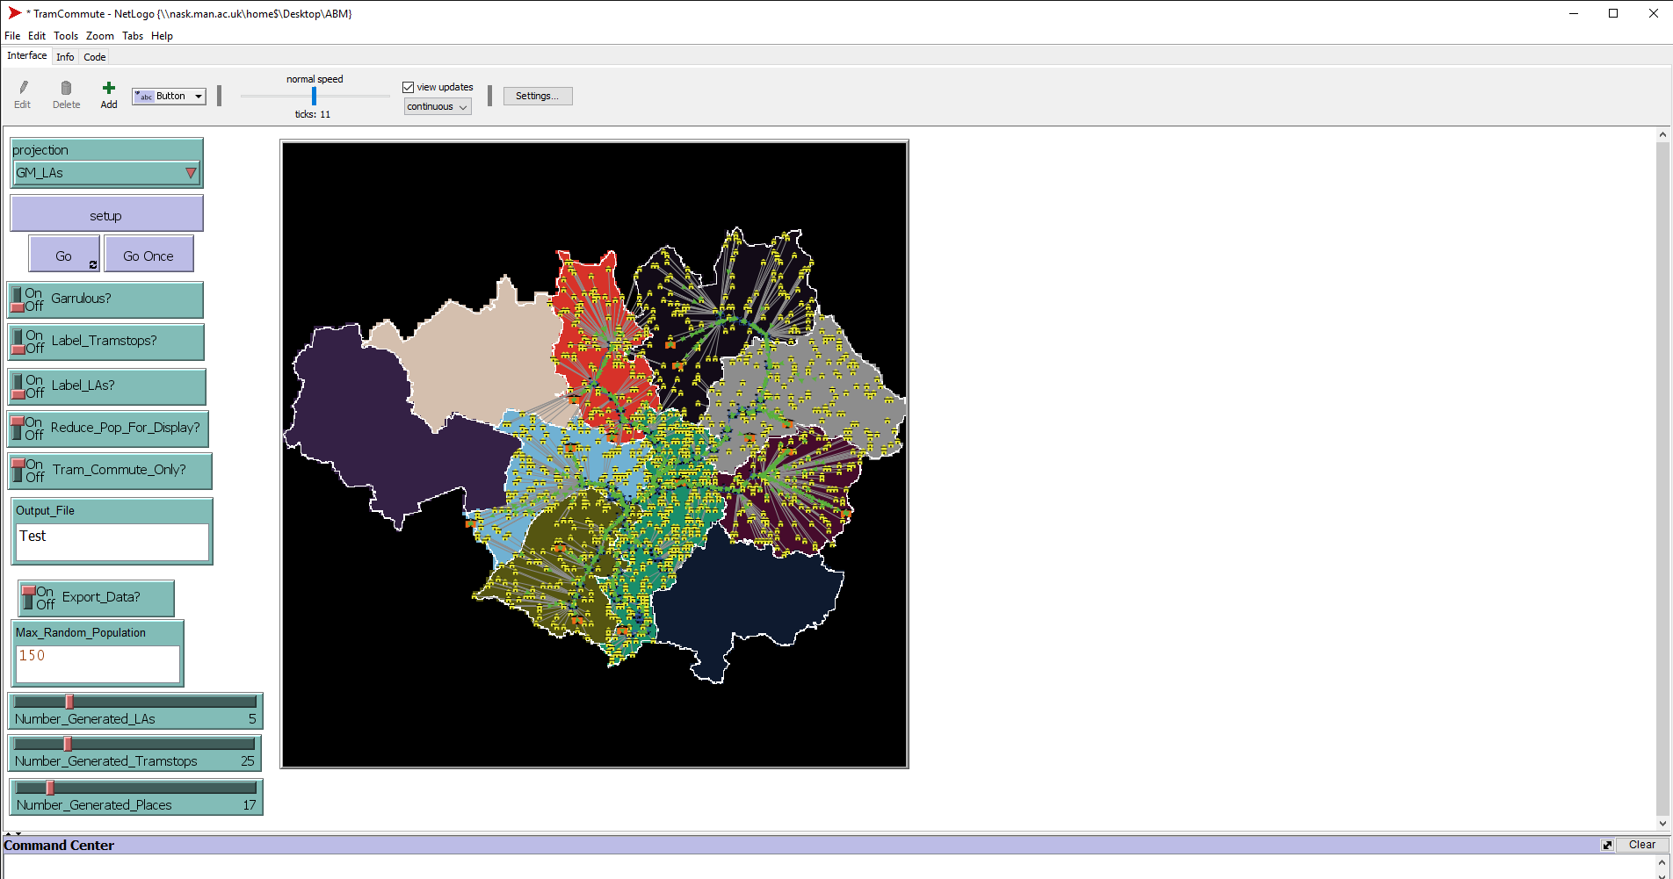
Revisit the "Tram commute model“
Notes:
If I zoom out from the visualizer, you may notice
CLICK
A couple of new items in the model interface. I added these because…
CLICK

Slide 9
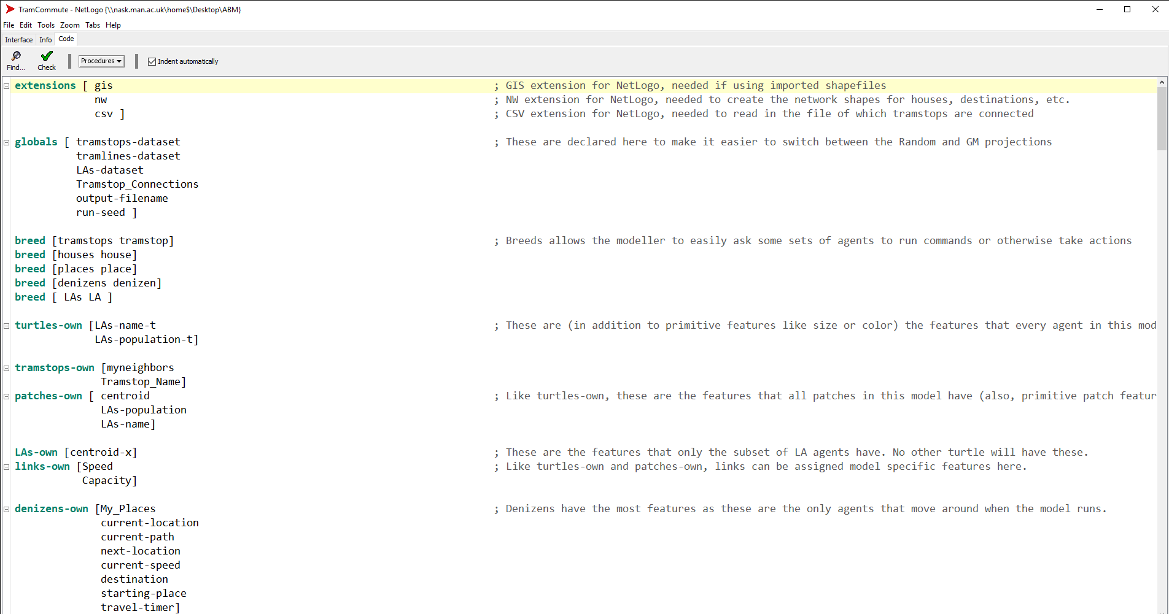
A couple of changes …
Notes:
I have made a few changes to the model code.
CLICK
For example, I added the .csv extension to make it easier to import and export information from .csv files.
CLICK
I have also adjusted a few other details, like added some new global features that are set during set up. For example, there is now a global variable called Tramstop_Connections …
CLICK

Slide 10
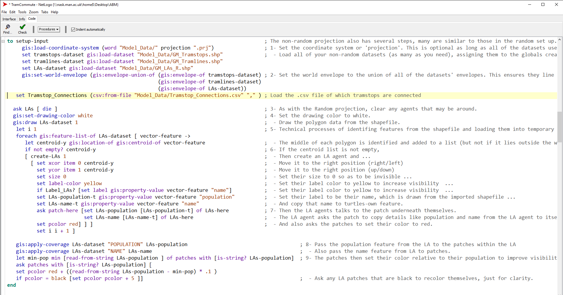
Import a .csv file …
Notes:
Which is where I store the contents of a .csv file that I open during the non-random setup procedure.
CLICK

Slide 11
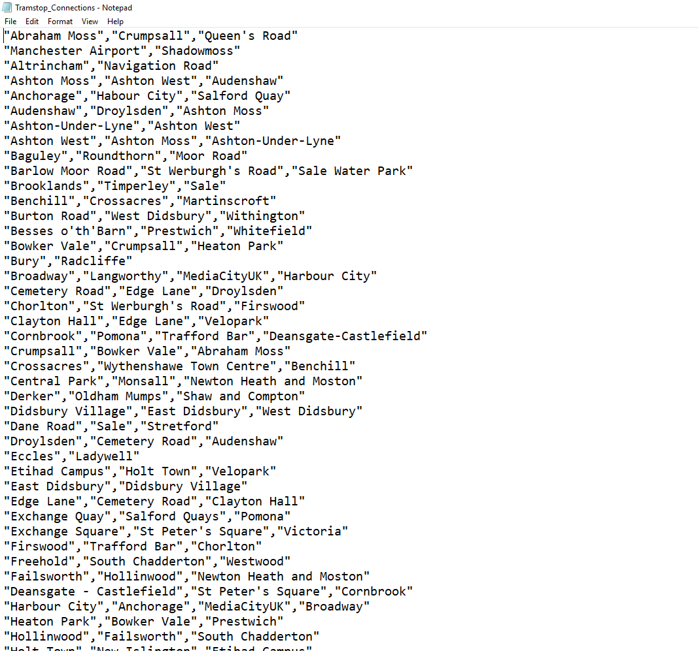
With a list of tram stops and their next stops…
Notes:
This is what that .csv file looks like.
Each row begins with a the name of a tram stop name, as it appears in the tramstop shapefile that I import separately.
The rest of the row contains all the tramstops that are one stop away from the first stop on the list.
CLICK
For example, Abraham Moss is next to both Crumpsal and Queen’s Road.
The rows do not have to be the same length. There are only 2 stops connected to Abraham Moss, but …
CLICK There are three stops connected to Cornbrook. The way I wrote the code takes care of it so it doesn’t matter how long each row is.

Slide 12
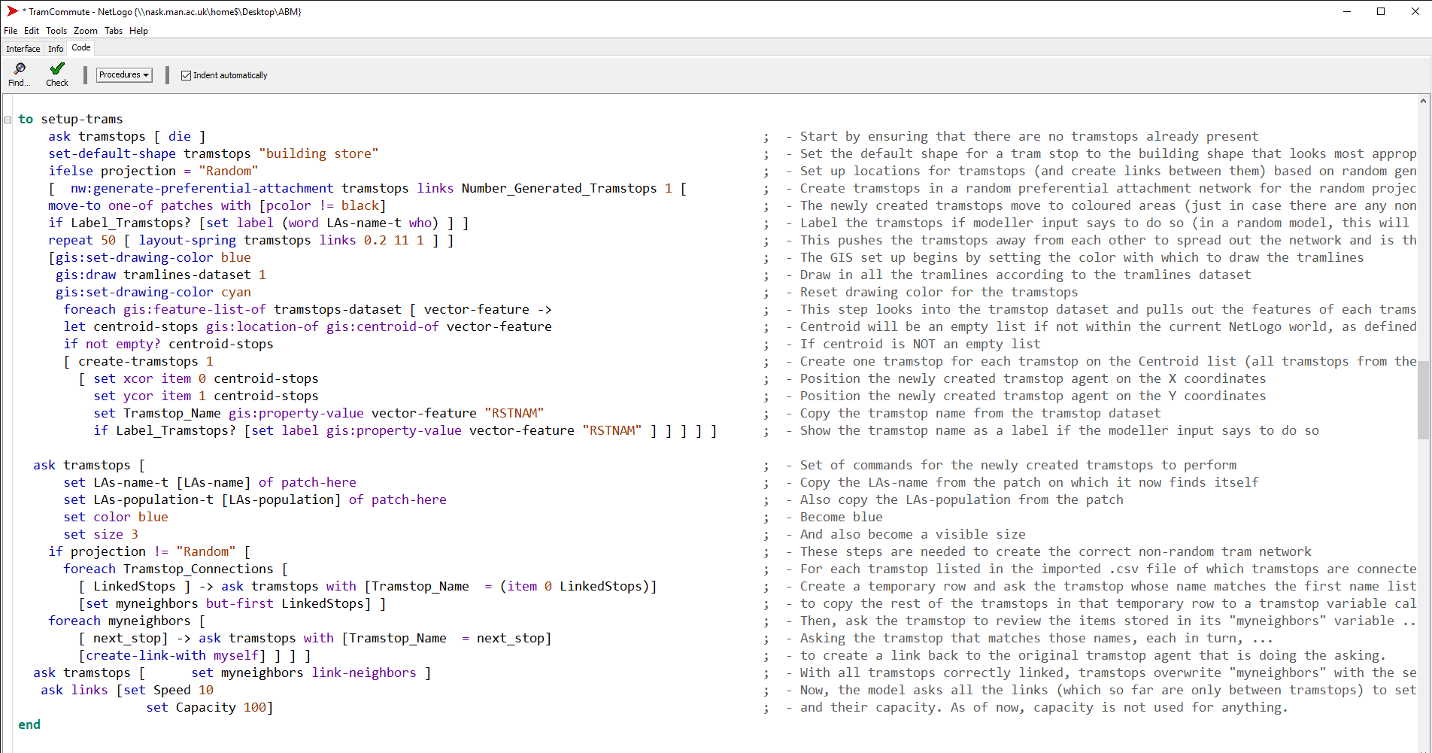
Model now opens .csv to link tram stop-agents
Notes:
I won’t spend too much time on the code now, because I will put the code online so you can download the model and have a look if you like.
CLICK
However, I do want to briefly point out that the “setup-trams” command draws tramlines and tram stops directly onto the map from the shapefiles and also saves the tram stop names as they appear in the shapefile.
CLICK
Then, this second part opens up the Tramstop_Connetions variable that holds the contents of the csv file.
The model reads through, line by line, finding each tram stop by name and connecting it to the tram stops that are one stop away.
Agents cannot share more than one undirected link, so it doesn’t matter if two stops each try to link to each other. The model checks and won’t allow duplicates.

Slide 13

Moving on!
Notes:
Now that we are familiar with our slightly modified Tram Commute model again, I want to talk about the Behaviour Space in Netlogo.
CLICK
Under the Tools menu …

Slide 14
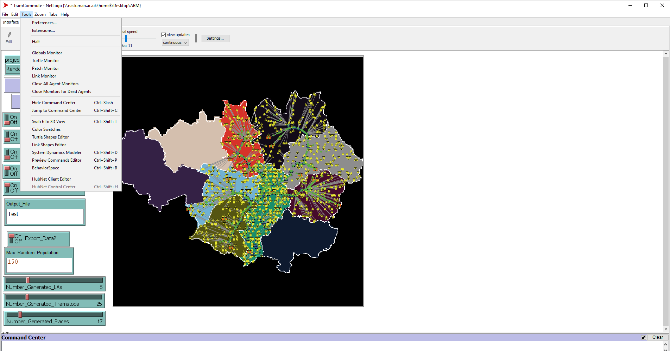
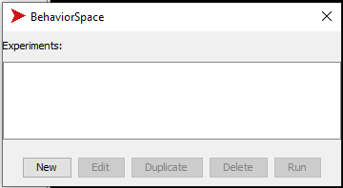
Behaviour Space
Notes:
You will find
CLICK
the Behaviour Space.
CLICK
Which opens up a window like this. The window is currently pretty empty because I have not yet created any experiments. To do that, I click
CLICK
“NEW” to start creating an experiment.

Slide 15
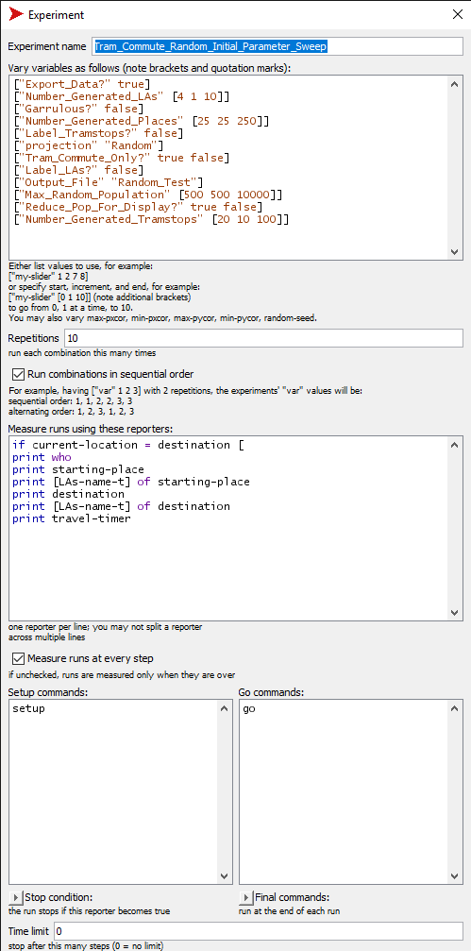
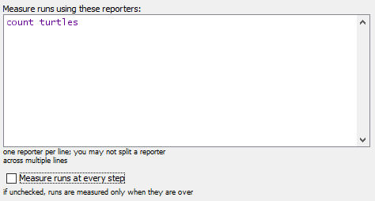
Behaviour Space
Notes:
This will open a new window in which you can set up experiments to run. You need to give the experiment a
CLICK
Name. Try to be descriptive or you will confuse yourself. Then,
CLICK
All of the parameters that you CAN set will already be present here when you open the window. You just need to decide how you want them set.
They can be set to a single value (Like I have “Projections” set to Random here)
Set to multiple values, as “Tram Commute Only” is set to both true and false
Or to a range with designated increments, as Number Generated Places is set to
CLICK
sweep from 25 to 250 in increments of 25. Then, you can set how many times you want to model to run at EACH unique combination of parameters.

Slide 16
Basic Behaviour Space output
Output options are built-in to the behaviour space interface.
BUT!
Choice to measure selected commands at every step or
Measure selected commands at end of run.
Swap out the above “if” command for a very basic “count tramstop-agents”
Notes:
As we saw earlier, the behaviour space has the capacity to report on model behaviour
CLICK
BUT!
CLICK
You only have the option to run these commands at every time step or
CLICK
At the end of the model.
CLICK
This is not great as neither of these allows me to let the agents report sometimes, but only at irregular times.
CLICK
So I just overwrote these “if” commands with a simple “Count tramstops” command to demonstrate.

Slide 17
Behaviour Space
Notes:
Then you decide how many repetitions you want to run AT EACH UNIQUE COMBINATION OF PARAMETER SETTINGS.
CLICK
You can decide what you want to measure and
CLICK
Whether you want those measurements taken at every single time step or only at the end of the run
CLICK
You can designate any special set up or go commands
CLICK
And you can put a time limit on how long the runs last.

Slide 18
Experiments on random projection
First experiments will be parameter sweeps:
All parameters vary
Wide ranges, big increments
Fewer repetitions
Then, use the results to run targeted sweeps with:
Maybe not all parameters
Narrower ranges and/or smaller increments
More repetitions
Or experiments
MANY repetitions on single/few settings
Changes to model code
Generate more tram stops, houses, or places
Generate more commuters
After some trigger or at a fixed point in time
Etc.
Notes:
The first experiments you run in the behaviour space should be parameter sweeps.
CLICK
Cover all the parameters and lots of area, but don’t go crazy with repetitions. These are not your real experimental work.
CLICK
The outcome of those parameter sweep experiments will let you know if you can ignore some variables, or if there is really only one reasonable way to set some variables, or if there is interesting stuff going on that needs more in depth exploration. These parameter sweeps may also tell you that something is wrong, for example if you start getting error readouts in your recorded output, etc. Or if the results are just nonsense.
Thus, the results of your first parameter sweeps will tell you if you need to go back to writing code or if you
CLICK
Move on to more targeted parameter sweep experiments. This time, maybe you use fewer parameters, narrower ranges, smaller increments and more repetitions to get a closer look.
There is not a right or wrong number of sweeps to run. It depends on your model, your resources, your research question, etc. Then, you use the results of these narrow sweeps to decide if
CLICK
You are ready to run full-scale experiments with lots of repetitions on only a few or select combinations of parameter settings or if you need to go back to your code and make more changes.

Slide 19
Random projection experiments needed to:
Verify model logic
Test model changes
Identify interactions of various parameters
Identify break points / critical ranges
Experiments
Write Code
Narrow Sweep
Wide Sweep
Notes:
Experiments are part of the process that moves from writing code through
CLICK
progressively more targeted parameter sweeps
CLICK
ultimately ending in experiments
But this is an iterative process and it kind of never ends. You will almost always end up with a model that you have some ideas about
CLICK
what else you might do with it or do to make it better.

Slide 20
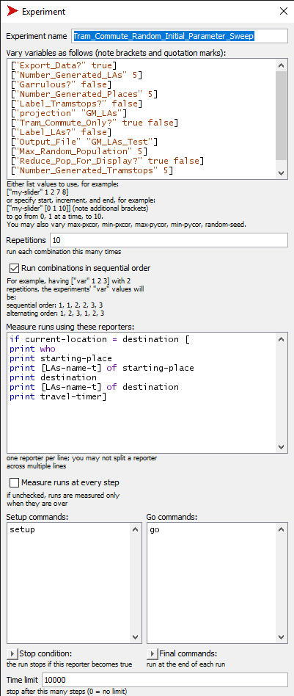
Behaviour Space
Notes:
Now, things are a bit different if we choose to use the GM_LA projection instead of the random one.
CLICK
Choose a different name
CLICK
And reset the parameters. The parameters for number of tramstops, number of commuters, and number of Las won’t affect this model because these values come from the shapefiles rather than modeller input.
So I can just set all of those to 5.
CLICK
I still vary the parameters that will matter, keep most of the rest of the things the same, but this time I took the screenshot after writing in a time limit.

Slide 21
Experiments on GM_LAs projection
First experiments are still parameter sweeps:
Still important to check model function
May not need as many rounds
Experiments
Can still repeat on large scale
Can change projection and/or model code
Start with oldest tramlines and add extensions at specified points in model run
Include currently agreed extensions (from beginning or at specified point in model run)
Include currently considered lines, rejected lines, totally imaginary lines, etc.
Others?
Notes:
This set of parameter sweeps will be much smaller, just because there are less parameters to vary.
CLICK
You may not even need a second round, if the first ones all go quite well.
CLICK But now you have a choice to either run A LOT of repetitions on a one or only a few combinations of parameter settings or go back to the model code and write in some more interesting behaviour.
Or you can do both. It is valid to document your research process through high repetition experiments at different points in the development.

Slide 22
GM_LAs projection experiments needed to:
Compare model behaviour to real-world observations
Test projection-specific model changes
Identify interactions of various parameters under realistic layout
Identify break points / critical ranges
Model possible outcomes of making changes
Answer specific research questions
Notes:
At this point, the reasoning behind your experiments will depend a lot of your research question.
You might want to try to replicate observations, explore solutions to identified problems, understand how much money might be raised by switching to a different fare scheme, etc.

Slide 23
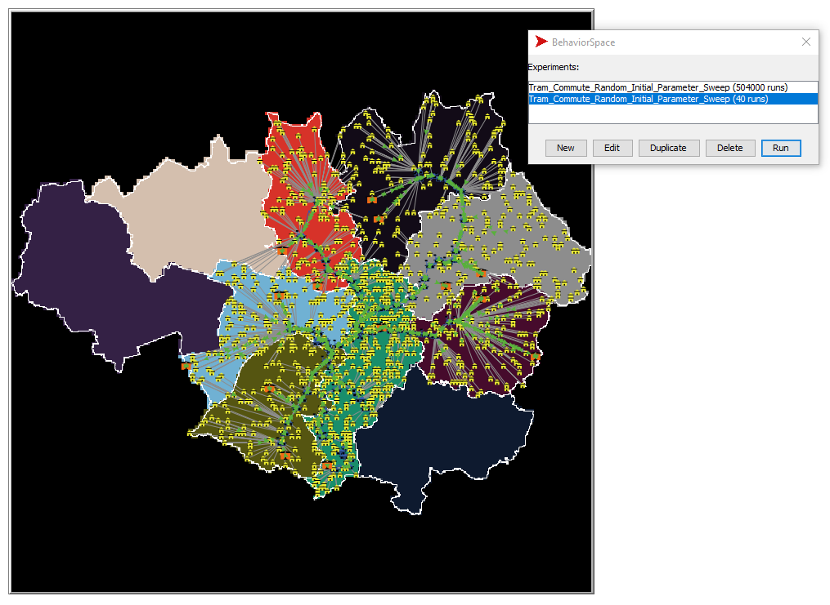
Parameter sweeps are part of model testing
Notes:
This is what the Behaviour Space looks like when it has two experiments set up.
We have some pretty self-explanatory choices here, so I will just
CLICK
Point out that there are many MANY more runs for the random model because it had so many more parameters to vary.
But, importantly, these are just stored until you actually run the experiments by
CLICK
Hitting the “run” button
Before I show you that, I want to talk a moment about output.

Slide 24
But first…
Ideal output is well-motivated by:
Research questions
Model design
Iterative developments
In this model, as it stands, I decided to look at output related to:
How long does it take to travel between one LA and another?
How common are trips within each LA and between Las?
With fairly minor changes we could also get output related to:
Most popular places to visit
Most used tram stops
More?
Notes:
You should be thinking about what kind of output you need all the way back at the beginning because
CLICK
Good output depends on consideration at the stage of the research questions, the model design, and the writing-parameter sweep-rewriting stages.
This model does not have amazing output because I don’t really have well though out research questions. Nevertheless, without making any changes, I could ask a couple
CLICK
Of basic exploratory questions like how long does it take to travel between Las? Or
How many trips are taken within an LA or between one LA and another?
CLICK
I could also, quite easily, make same changes that ask place-agents or tram-stop agents to report how many commuters are present at any given moment, thereby creating some output to show how visits are distributed.

Slide 25
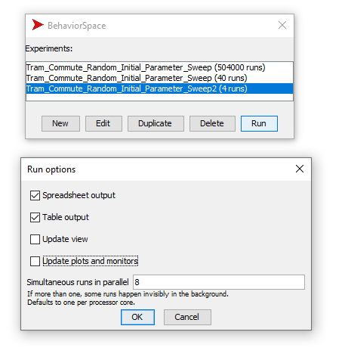
Hitting the Run button
Notes:
Hit the run button brings up a
CLICK
new window that lets you decide if you want your basic output in
CLICK
a table, spreadsheet or both.
And also allows you to decide if
CLICK you want to see the model running or if it should just run quietly in the background to save computing power. Make your decisions and hit
CLICK
OK.

Slide 26
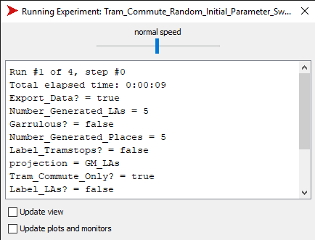
Experiments need output!
Notes:
Assuming you saved power by choosing to not update on every timestep
CLICK
You will see this window with your experiment name at the top and
CLICK A summary of what is going on. Since this demonstration experiment only has 4 runs, it finished pretty quickly

Slide 27
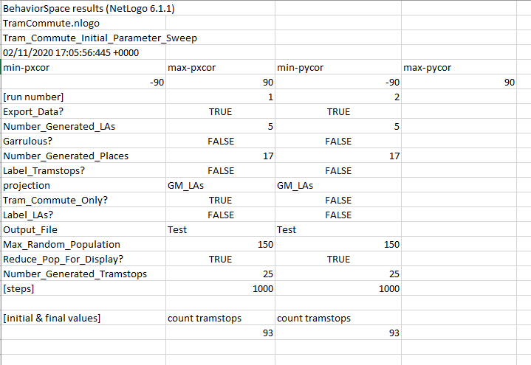
Behaviour Space standard output - spreadsheet
Notes:
This is some basic model output in the standard NetLogo Table output
CLICK
Model run details are recorded at the top
CLICK
Model parameters are recorded below that
CLICK And finally, the count of tramstop agents that I asked for.

Slide 28
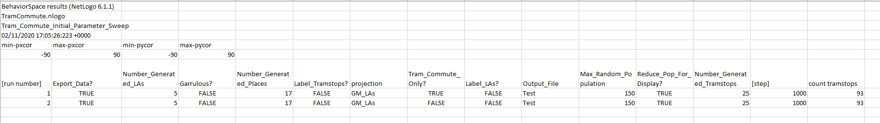
Behaviour Space standard output - table
Notes:
And here is the same information in the standard NetLogo Table output

Slide 29
Alternate output
Output options are built-in to the behaviour space interface.
Choice to measure selected commands at every step or
Measure selected commands at end of run.
Spreadsheet or table options
Other output options can be built directly into the model code.
Notes:
Obviously, the basic output in the behaviour space can be much more sophisticated than what I showed you here. You can do things on some time steps and not others, but it is complicated.
But you get limited formats and it always comes with the model description stuff at the top.
CLICK
You may prefer to build exactly the output you want to see directly into the model code.

Slide 30
Exports in setup
Notes:
If you remember, I showed you earlier that there is a
CLICK
CSV extension.
I used it already to import a list of which tramstops are adjacent but it also is useful for exporting.

Slide 31
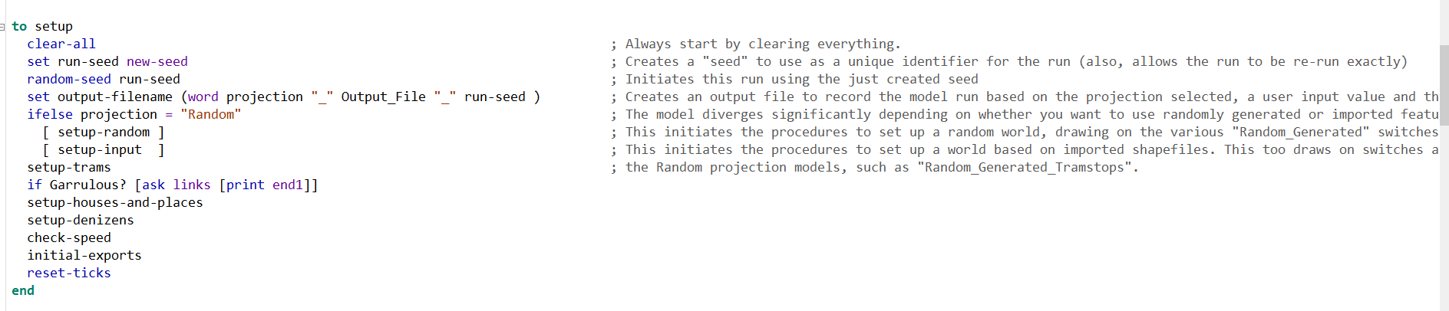
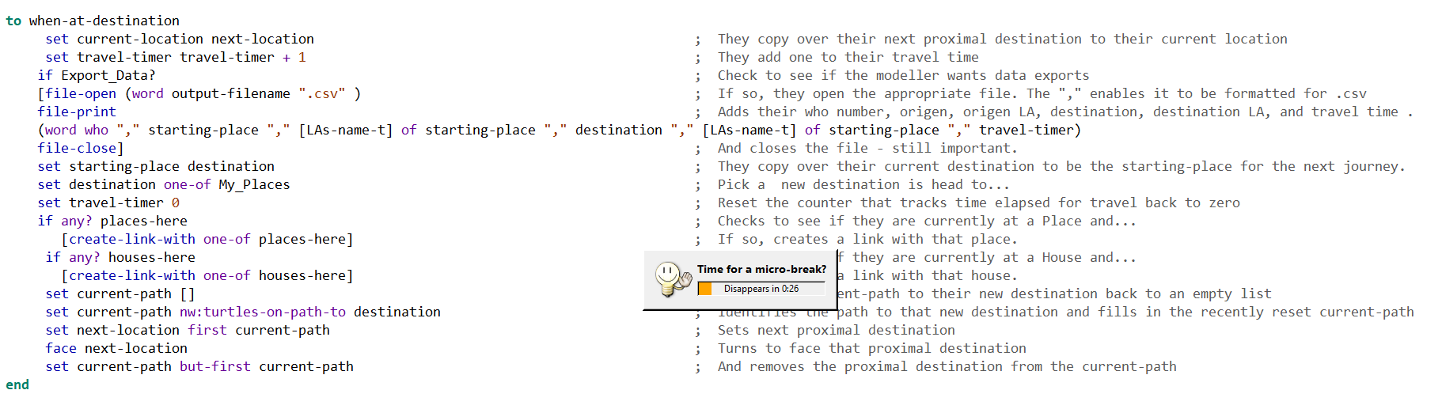
Exports in setup
Notes:
In the setup command, I added
CLICK
A command to do “initial exports” which
CLICK
Looks like this and which
CLICK
Creates a new csv file for this specific model run and prints a header row in it
CLICK
Then, during the model run, every time a commuter arrives at its destination
CLICK
The model opens that file and prints out a line with the commuter-agent ID, its origen, origen LA, destination, destination LA and how many time steps it took to get there.

Slide 32
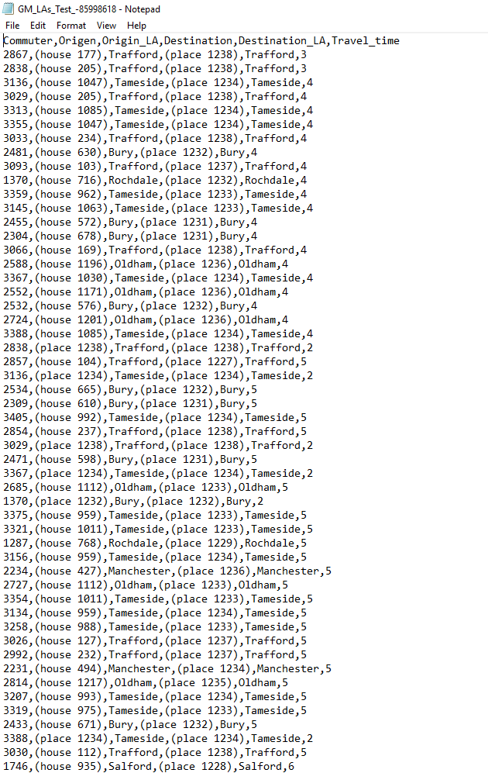
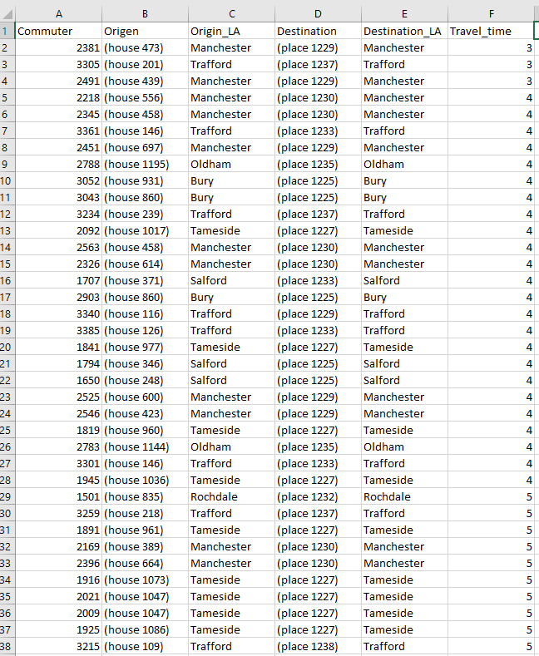
One file per run
Notes:
This is what one of those output files looks like in
CLICK
Basic notepand or in
CLICK
Excell

Slide 33
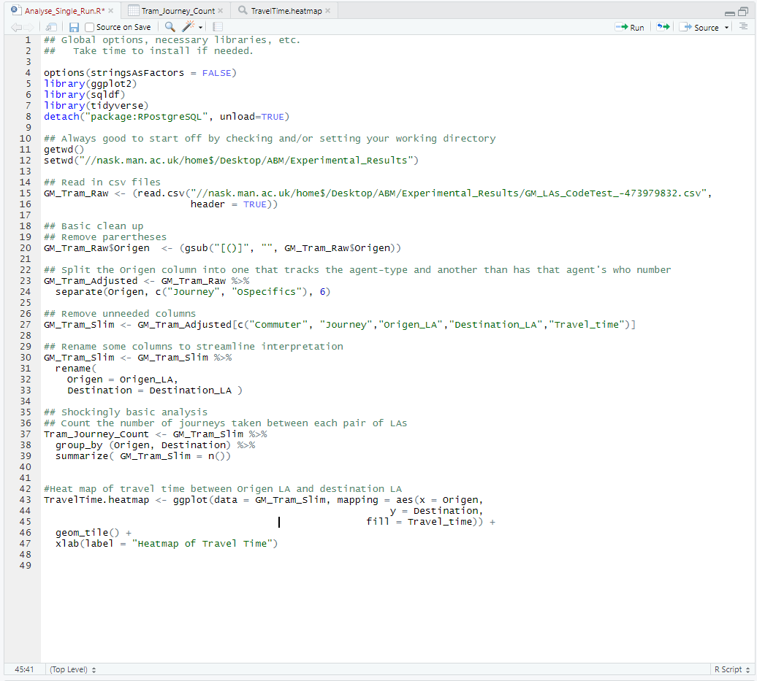
Open in RStudio
Notes:
Now that we have our output, we need to analyse it. I chose to do that in Rstudio, but you may prefer another option.
I won’t go into too much depth here, because if you have a different process then details about exactly what I did in R won’t help. But the basics are
CLICK
First, read in the csv file, which will appear as an object.
CLICK
Have a look at that file to check it out.

Slide 34
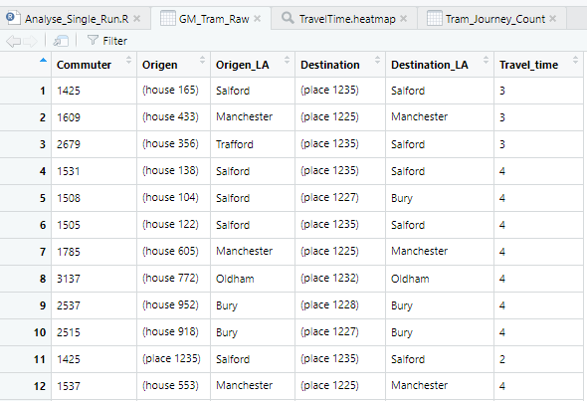
Look at raw file
Notes:
When I look at it, I notice that
CLICK
These columns have parentheses. Also, I don’t really need to know which house they came from, just if their journey started at home or not.

Slide 35
Open in RStudio
Notes:
So, I run a few data wrangling steps to
CLICK
Remove the parenthases and split the origin column into two separate columns, one called journey and one called Ospecifics.
CLICK
Then I create a subset of the data by selecting only some of the columns to keep, saving it under a new name.
CLICK
Then, for funsies, I rename some columns to be a bit more readable. Apologies for maintaining the typo.

Slide 36
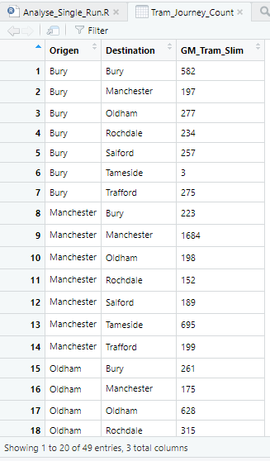
Open in RStudio
Notes:
Now, I did this pretty super quick, so further apologies for being so basic.
The analysis consists of pretty much just
CLICK
A count of how many journeys there are, grouped by origin and destination. This allows for a quick look at how many journeys start and end within a given LA or start in one and end in another.
A slightly cooler analysis is CLICK
Creating a heatmap based on how long it takes to make journeys based on the origin and destination LA.

Slide 37
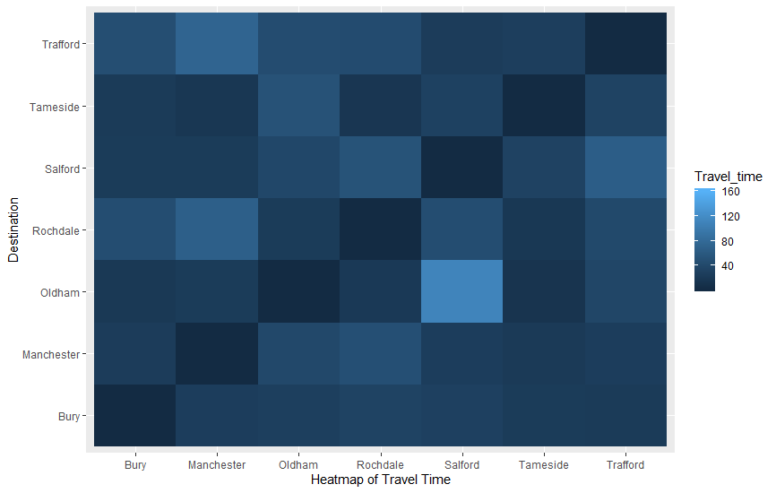
Open in RStudio
Notes:
Obviously, journeys that start and end within the same LA
CLICK
Have the fastest journey times. Interestingly, jouneys that start in Salford and end in Oldham have
CLICK
really long travel times. Longer even than journeys that start in
CLICK Oldham and end in Salford. Might be something to look into, which, as these are initial testing sort of experiments, is fine.

Slide 38
Summary
Revisit the "Tram commute model“
Behaviour Space
Consider what experiments to run –
parameter sweeps
targeted research questions
Building output creation into your model code – an optional extra
Open output
Process
Analyze
Visualise
https://www.comses.net/codebases/5ec74433-0536-4343-88fd-8385e7f5066c/releases/1.0.0/
Or
https://tinyurl.com/wagewt9
Notes:
Just a quick summary of what we have moved through today.

Slide 39


Dr. J. Kasmire
julia.kasmire@manchester.ac.uk
@JKasmireComplex
ukdataservice.ac.uk/help/
Subscribe to UK Data Service news at https://www.jiscmail.ac.uk – search UKDATASERVICE
@UKDataService
UKDataService

